Slide 1
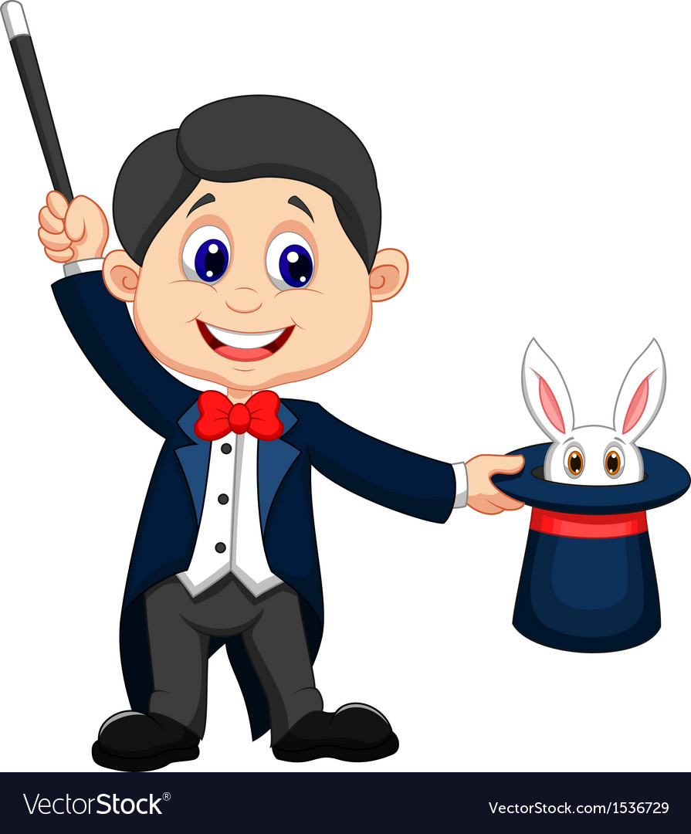
浙江省 Z20 联盟三模 读后续写讲解
A Magician’s secret

Slide 2
阅读下面短文，根据所给情节进行续写，使之构成一个完整的故事 Marty was new at school. Usually when you’re the new kid, you lay low, but not Marty. On his first day, he made a toothpick disappear. One second he was holding the toothpick, and the next second it was gone! Everyone was asking him how he did it. “It’s magic! At my old school, they actually called me Magic Marty.” Marty said proudly. “Is he serious?” I whispered to my friend Brian. “ I don't know, but that was pretty cool,”Brian said, still watching Marty. I knew Marty’s magic was fake, but I just couldn’t prove it. Another time, Marty pulled a water bottle out of his bag, along with a cup and carefully poured water into it. Marty got a handful of ice cubes! Applause filled the hallway. When asked how he did it, he just smiled, “Sorry, but that’s the first law of magic. A magician never reveals his secrets.” Well, he won’t have to, I thought to myself. I’ll reveal his secrets for him. That night, at home, I sat at the kitchen table for almost an hour, trying to figure out the trick. At it again, honey?” My mom watched me wiggle(摆动）my fingers hopelessly over a cup of water. “He’s tricking people!” I cried. “Sounds as if he’s trying to make friends.” My mom patted my arm. Magic Marty had me stumped (把...难住)，but the next day I caught a lucky break. At lunch, Marty was going on about how he could make things float. He had a ring in one hand and a pencil in the other. That’s when I saw it: a thin piece of fishing line tied around the end of the pencil and attached to a button on Marty’s shirt! Sure enough, he made the ring “float” by sliding it over the pencil and hanging it from the line. No one else noticed, and soon the whole cafeteria was clapping. However, I wasn’t.
续写： Paragraph 1: It was time to put an end to the Magic Marty show.____________________________________________________________
______________________________________________________________________________________________________________________________________________________________________________________________________________ Paragraph 2: “Wait!” Marty jumped in front of me.______________________________________________________________________

Slide 3
捕捉和照应原文
留意细节描写
关注特
定情节
关注高频词
提炼
主题
留意原文结尾
品读
首段
解读续写首句
照应

Slide 4
Marty was new at school. Usually when you’re the new kid, you lay low, but not Marty.
On his first day, he made a toothpick disappear. One second he was holding the toothpick, and the next second it was gone! Everyone was asking him how he did it. “It’s magic! At my old school, they actually called me Magic Marty.” Marty said proudly. “Is he serious?” I whispered to my friend Brian. “ I don't know, but that was pretty cool,”Brian said, still watching Marty. I knew Marty’s magic was fake, but I just couldn’t prove it.
Another time, Marty pulled a water bottle out of his bag, along with a cup and carefully poured water into it. Marty got a handful of ice cubes! Applause filled the hallway. When asked how he did it, he just smiled, “Sorry, but that’s the first law of magic. A magician never reveals his secrets.”
Well, he won’t have to, I thought to myself. I’ll reveal his secrets for him.
background/ my comments: not stay low
different responses to Marty’s magic
Marty’s insistence and my determination

Slide 5
That night, at home, I sat at the kitchen table for almost an hour, trying to figure out the trick. “At it again, honey?” My mom watched me wiggle(摆动）my fingers hopelessly over a cup of water. “He’s tricking people!” I cried. “Sounds as if he’s trying to make friends.” My mom patted my arm.
Magic Marty had me stumped (把...难住)，but the next day I caught a lucky break. At lunch, Marty was going on about how he could make things float. He had a ring in one hand and a pencil in the other. That’s when I saw it: a thin piece of fishing line tied around the end of the pencil and attached to a button on Marty’s shirt! Sure enough, he made the ring “float” by sliding it over the pencil and hanging it from the line. No one else noticed, and soon the whole cafeteria was clapping. However, I wasn’t.
my attempt to reveal Marty’s trick and mother’s comments
Then came my luck

Slide 6
plots
three magic tricks
Evalution:
EvaluationEveryone: Applause filled the hallway.
I: well, he won’t have to, I thought to myself.I’ll reveal his secrets for him.
“He’s tricking people!”
Mother: “Sounds as if he’s trying to make friends.”
Marty: When asked how he did it, he just smiled, “Sorry, but that’s the first law of magic. A magician never reveals his secrets.”
I：envious/jealous ;
eager to reveal him;impatient
I: angry, excited, satisfied, confident
I:curious, confused,
doubted,envious/jealous
Evalution:
Everyone: No one else noticed, and soon the whole cafeteria was clapping.
I :Magic Marty had me stumped (把...难住)，but the next day I caught a lucky break. No one else noticed, and soon the whole cafeteria was clapping. However I wasn’t.
Evaluation:
Everyone:Everyone was asking him how he did it.
Brian: Brian said, still watching Marty.
I: I whispered to my friend Brian. I knew Marty’s magic was fake, but I just couldn’t prove it.
Marty: “It’s magic! At my old school, they actually called me Magic Marty.”Marty said proudly.
Action:
He had a ring in one hand and a pencil in the other. ...a thin piece of fishing line tied around the end of the pencil and attached to a button on Marty’ s shirt!
Marty: happy, content, proud
Action:
Marty pulled a water bottle out of his bag, along with a cup and carefully poured water into it. Marty got a handful of ice cubes.
Marty:proudly, excited
Action:
he made a toothpick disappear.
one second he was holding the toothpick, and the next second it was gone!
Marty: confident, proud, happy
③
the next day
②
another time
①
time order
on his first day

Slide 7
校园故事多半关乎友情，魔术师马蒂也不例外。（比如《瓦伦丁恶作剧》里的Jackson？）
高调出场的Marty吸引了同学的关注，但Marty的“嚣张”和“得意”激发了我的斗志，于是第四段作者立志要揭露Marty的诡计Well, he won't have to, I thought to myself. I'll reveal his secrets for him. 在接下来的第五段中，我在晚上试图还原Marty白天变的魔术，但是没有成功。这让我很不甘心，但母亲的一句话给后文埋下了伏笔，Sounds as if he's trying to make friends. 母亲拍拍我的肩膀宽慰我，毕竟Marty是个新生，他刚到这个学校，需要引起别人的关注并交到知心的朋友。
但作者并不管这些，他只想拆穿这个伪君子的真面目。

Slide 8
机会出现在第二天他表演悬浮戒指的时候，我看到了那条隐线，这是揭穿他的最好时机了。It was time to put an end to the Magic Marty show.
那么我们需要考虑的第一段续写内容就是作者到底有没有去揭穿Marty?第二段首句是"Wait!" Marty jumped in front of me. 从这句话我们无从得知第一段到底有没有揭穿，但是从故事情节推测，既然作者已经看到了，揭穿他又是作者一直以来的想法，那么他肯定会有所动作。
关键在于怎么揭穿？如果当中义正言辞地揭秘，则整个故事的走向就有点“向恶”，给后续第二段增加了难度；所以最理想的设计就是我揭穿了，但还是给Marty留了情面，Marty为了表示感谢，在第二段中教了我一些魔术，揭露了前面提到的魔术的奥秘。后来我和他成了好朋友，Marty也完成了从fake magician到real friend的转变。

Slide 9
theme? reflection？
cheating? Friendship should be based on siscerity?
What’s real magic?
making new friends by magic
Being friends with Marty is a magic for me.

Slide 10
Paragraph 1: It was time to put an end to the Magic Marty show.____________
1) Did “I” really end the magic show?
Quetions
2) How did I end it? What did I say? What did I do? How did I feel?
3) How did everyone respond?
回原文去捕捉照应点
4) Did Marty discover my intention?
5) How did he feel? What did he do?
Paragraph 2: “Wait!” Marty jumped in front of me._________________
1) Why did he jump in front of me? What did he want to do ?why?
Quetions
2) Did he stop me from telling the secret successfully? why? why not?
3) What was my reponse?
解读续写首句
4) How did everyone respond?
5) What did the story want to tell us?

Slide 11
需要注意的问题：
1.善于用动作链
Marching towards him as fast as I could, I reached out my hand ,grabbed the fishing line and showed it to the classmates.
2用肢体动作， 心理描写，脸部表情等增加文章的生动性
Marty was too shocked to move a single inch, the pride glittering/ glistening in his eyes changing into complete astonishment.
At mere sight of his serious face, I felt my heart skipped a beat, fearing I would get a sound blow from him.
3.语言/对话不宜过多
4.紧扣主题的情节发展(向善，making new friends）；延续前文人物性格；前文的协同性
5注意过渡，主位推进法

Slide 12
三、结局/结果result/resolution
一系列事件的结束，包括人物的下场，目的的实现或失败
指向部分：
Marty was new at school. Usually when you’re the new kid, you lay low, but not Marty.
品读
首段
(照应）结尾： After the show, Marty was still not a low-key boy but a true super star. He kept performing magic shows for us, with me as his only assistant.

Slide 13
On his first day, he made a toothpick disappear. One second he was holding the toothpick, and the next second it was gone! Everyone was asking him how he did it. “It’s magic! At my old school, they actually called me Magic Marty.” Marty said proudly. “Is he serious?” I whispered to my friend Brian. “ I don't know, but that was pretty cool,”Brian said, still watching Marty. I knew Marty’s magic was fake, but I just couldn’t prove it.
照应（结尾）Marty kept performing magic shows at school. He finally became our “Magic Marty”.
照应（续写第一段) Luckily, the evidence brought the possibility of proving his magic was fake.
关注特
定情节

Slide 14
照应（结尾）：We performed the magic shows together, with applause filling the whole room.
Another time, Marty pulled a water bottle out of his bag, along with a cup and carefully poured water into it. Marty got a handful of ice cubes! Applause filled the hallway. When asked how he did it, he just smiled, “Sorry, but that’s the first law of magic. A magician never reveals his secrets.” Well, he won’t have to, I thought to myself. I’ll reveal his secrets for him. That night, at home, I sat at the kitchen table for almost an hour, trying to figure out the trick. At it again, honey?” My mom watched me wiggle(摆动）my fingers hopelessly over a cup of water. “He’s tricking people!” I cried. “Sounds as if he’s trying to make friends.” My mom patted my arm.
关注高频词
照应（第二段）：（Marty向我解释）with determination, he looked into my eyes,” I know you think I’m tricking people. But as a magician, never revealing his secrects is the first law of magic. I just want to bring happiness to others. I...I’m just trying to make friends in this school.” He looked over my shoulders, a strong loneliness enveloping him.
照应（第一段）：（after discovering the secret) ” Cheater! ” Curling my fist angrily, I couldn’t wait to reveal his secrets,

Slide 15
Magic Marty had me stumped (把...难住)，but the next day I caught a lucky break. At lunch, Marty was going on about how he could make things float. He had a ring in one hand and a pencil in the other. That’s when I saw it: a thin piece of fishing line tied around the end of the pencil and attached to a button on Marty’s shirt! Sure enough, he made the ring “float” by sliding it over the pencil and hanging it from the line. No one else noticed, and soon the whole cafeteria was clapping. However, I wasn’t.
照应（续写第一段）I would never missed the lucky break-- I must prove he was tricking everyone. The fishing line was the secret.
照应（续写第一段）Hearing my words, the whole cafeteria was boiling.

Slide 16
捕捉和照应原文
留意细节描写
关注特
定情节
关注高频词
提炼
主题
留意原文结尾
品读
首段
解读续写首句
照应

Slide 17
possible version 1
Paragraph 1：
It was time to put an end to the Magic Marty show. I walked over. “It was fishing line.” I sneered, folding my arms. Marty subconsciously fingered the fishing line and nervously whispered, “So, are you going to tell people?” Seeing the panic in his eyes, somehow, I hesitated. Should I reveal the secret, Marty might lose his new friends. Finally, after struggling for a moment, I replied, “Nah, I won’t say anything.” Marty let out a relieved sigh, and I turned to walk away.

Slide 18
Paragraph 2：
“Wait!” Marty jumped in front of me. Unexpectedly, he patted my arm, grinning, “You’ve got a pretty good eye for magic. Want to join me?” I nodded joyfully. That’s how the Magic Marty and Mysterious Matt Lunch Show began. Now we’ve been a magic team for three months. And since I became a fellow magician, Marty has let me in on (让我参与）some of his other tricks. It turns out that instead of a fake magician, Marty is a real friend.

Slide 19
possible version 1
Paragraph 1：
It was time to put an end to the Magic Marty show. I walked over. “It was fishing line.” I sneered, folding my arms. Marty subconsciously fingered the fishing line and nervously whispered, “So, are you going to tell people?” Seeing the panic in his eyes, somehow, I hesitated. Should I reveal the secret, Marty might lose his new friends. Finally, after struggling for a moment, I replied, “Nah, I won’t say anything.” Marty let out a relieved sigh, and I turned to walk away.
Paragraph 2：
“Wait!” Marty jumped in front of me. Unexpectedly, he patted my arm, grinning, “You’ve got a pretty good eye for magic. Want to join me?” I nodded joyfully. That’s how the Magic Marty and Mysterious Matt Lunch Show began. Now we’ve been a magic team for three months. And since I became a fellow magician, Marty has let me in on some of his other tricks. It turns out that instead of a fake magician, Marty is a real friend.
照应原文结尾
照应特定情节
结果/结局: I didn’t reveal the secret. Marty and became friends, and played magic together.
回应:魔术假，友情真。
照应开头
照应厨房练习情节
照应文章主题

Slide 20
Possible version 2:
Paragraph 1：
It was time to put an end to the Magic Marty show. Excited at the thought, I couldn‘t resist crying out, ”It was fishing line!“ Totally surprised at my abruptness, all the classmates including Marty had their attention fixed on me, waiting for an explanation. I pulled out the fishing line to reveal his secrets in front of the classmates. Marty lowered his head with a burning face. Having broken the first law of his proud magic, I was about to stalk off(扬长而去）.

Slide 21
Paragraph 2：
“Wait!” Marty jumped in front of me. With lips trembling, he attempted to say something but in vain and tears were rolling in his eyes. It suddenly occurred to me what magic meant to him. My satisfaction vanished, turning into the shame of jealousy. To Marty, all he had done was merely to befriend more people at school. Out of guilt and regret, I explained my original intention and apologized. Only then did I appreciate never should jealousy gain the upper hand（get the best of me) at any time.

Slide 22
Possible version 2:
Paragraph 1：
It was time to put an end to the Magic Marty show. Excited at the thought, I couldn‘t resist crying out, ”It was fishing line!“ Totally surprised at my abruptness, all the classmates including Marty had their attention fixed on me, waiting for an explanation. I pulled out the fishing line to reveal his secrets in front of the classmates. Marty lowered his head with a burning face. Having broken the first law of his proud magic, I was about to stalk off(扬长而去）.
Paragraph 2：
“Wait!” Marty jumped in front of me. With lips trembling, he attempted to say something but in vain and tears were rolling in his eyes. It suddenly occurred to me what magic meant to him. My satisfaction vanished, turning into the shame of jealousy. To Marty, all he had done was merely to befriend more people at school. Out of guilt and regret, I explained my original intention and apologized. Only then did I appreciate never should jealousy gain the upper hand at any time.
照应原文结尾
照应第二次魔术
照应第一次魔术
结果/结局: I revealed the secret. Marty was sad. I apologized to Marty .
回应:theme: never be jealous
照应第一次魔术
照应主题

Slide 23
possible version 1
Paragraph 1：
It was time to put an end to the Magic Marty show. I walked over. “It was fishing line.” I sneered, folding my arms. Marty subconsciously fingered the fishing line and nervously whispered, “So, are you going to tell people?” Seeing the panic in his eyes, somehow, I hesitated. Should I reveal the secret, Marty might lose his new friends. Finally, after struggling for a moment, I replied, “Nah, I won’t say anything.” Marty let out a relieved sigh, and I turned to walk away.
Paragraph 2：
“Wait!” Marty jumped in front of me. Unexpectedly, he patted my arm, grinning, “You’ve got a pretty good eye for magic. Want to join me?” I nodded joyfully. That’s how the Magic Marty and Mysterious Matt Lunch Show began. Now we’ve been a magic team for three months. And since I became a fellow magician, Marty has let me in on some of his other tricks. It turns out that instead of a fake magician, Marty is a real friend.
照应原文结尾
照应特定情节
结果/结局: I didn’t reveal the secret. Marty and became friends, and played magic together.
回应:魔术假，友情真。
照应开头
照应厨房练习情节
照应文章主题

Slide 24
Possible version 2:
Paragraph 1：
It was time to put an end to the Magic Marty show. Excited at the thought, I couldn‘t resist crying out, ”It was fishing line!“ Totally surprised at my abruptness, all the classmates including Marty had their attention fixed on me, waiting for an explanation. I pulled out the fishing line to reveal his secrets in front of the classmates. Marty lowered his head with a burning face. Having broken the first law of his proud magic, I was about to stalk off(扬长而去）.
Paragraph 2：
“Wait!” Marty jumped in front of me. With lips trembling, he attempted to say something but in vain and tears were rolling in his eyes. It suddenly occurred to me what magic meant to him. My satisfaction vanished, turning into the shame of jealousy. To Marty, all he had done was merely to befriend more people at school. Out of guilt and regret, I explained my original intention and apologized. Only then did I appreciate never should jealousy gain the upper hand at any time.
照应原文结尾
照应第二次魔术
照应第一次魔术
结果/结局: I revealed the secret. Marty was sad. I apologized to Marty .
回应:theme: never be jealous
照应第一次魔术
照应主题

Slide 25
冲刺阶段的reminder
关于冲刺阶段读后续写复习的小贴士：
1）简要梳理做题的流程和技巧，掌控好时间。
2）保持适当的练习量（95分）。保持练习，熟悉手感和作文速度。
3）保证记忆时间，摘抄的语料库中的好的表达，继续记性背诵直到高考那天，常见表达要脱口而出，最大化地争取考试时的有效时间。
4）带着评判性去看范文和习作范文，提出修正意见。

Slide 26
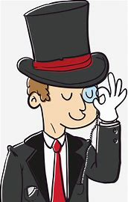
Thank you！

